Slide 1
Volunteer Orientation
Volunteer Program & Central Records Office (CRO)
379 Washington Street
Providence RI 02903
P: (401) 456.9239
F: (401) 278-2878
Email: CRO@ppsd.org
SY 2021-2022

Slide 2
Objective and Agenda
Objective
Equip volunteers with the tools to become successful in Providence Public Schools.
Agenda
Intro
Why Volunteering?
Virtual Volunteering
Volunteer Policy
Covid-19
Volunteer Application 3 Steps Process
What happens after you have completed application
Legal Process
Protocols
Volunteer to do list
Q&A
Thank you!

Slide 3
Why Volunteer?
Make a difference | A chance to give back
To meet new people | Brings people together
Strengthens Communities | Gain Professional Experience
Service Learning
Qualities of a volunteer
Commitment | Creativity
Integrity | Flexibility
Compassion | Being proactive
Network

Slide 4
Virtual volunteering
Virtual Volunteering
When volunteer activities occur, in whole or in part, using the internet and a home, school, tele center, or work computer or other internet-connected device, such as a smart phone or personal digital assistant.
What does that look like?
Supporting…
students with virtual learning/google classroom
our virtual learning academy call help line
parents with any concern with the VLA program
filing & storage/data collection FACE Office
Tutoring and mentoring

Slide 5
Volunteer Policy
Volunteer Policy
English
https://pesb.ppsd.org/Reference_Library/ESB_Policies_and_Regulations/Policies//Volunteer%20Policy-Amended-6.27.2018.pdf
Spanish
https://www.providenceschools.org/cms/lib/RI01900003/Centricity/Domain/124/Volunteer%20Policy-Amended-6.27.2018%20SPANISHFINAL.pdf
The purpose of the policy is to establish the guidelines for the approval and training of volunteers in District schools, including the roles, responsibilities, and expectations of volunteers within our schools. This policy applies to parents and community members who volunteer on an individual basis, or through our various Parent Teacher Organizations, both on and off District property, and during and outside of the school day.

Slide 6
Covid-19
Relief for Workers: If you need to stay home because of COVID-19, there are resources for you. Please do not go into work if you are sick. More
Prevent the Spread of COVID-19 in Schools and Other Buildings by Circulating Air: The virus that causes COVID-19 can spread from one person to another in tiny particles of water and virus called aerosols. We make these aerosols when we breathe, and we make more of them when we talk, yell, or sing. Aerosols are different than larger droplets that spread COVID-19. Larger droplets fall to the ground quickly, three to six feet from the person who makes them. Aerosols can stay floating in the air for hours and can travel long distances. Aerosols have less virus in them than the larger droplets, so you have to inhale more aerosols to get sick. Aerosols can build up if the air inside is not circulated the right way. more
Wearing a face covering in public places helps protect you and anyone near you from COVID-19. Your mask should fit snugly but comfortably over your nose, mouth, and chin without any gaps.

Slide 7
Volunteer 3 steps Application Process
Orientation:
Attend a Volunteer Orientation session. Volunteer applications are available during orientation sessions, at all school’s main offices and the district website at https://www.providenceschools.org/Page/4224
Application:
Complete the application and obtain a state Bureau of Criminal Investigation check (also known as BCI). You may personally request a BCI at the RI Attorney General’s Office, 4 Howard Avenue, Cranston, RI 02910. Hours are from 8:30-4:30 Monday – Friday. You must provide a valid picture ID and $5 check or money order made payable to BCI
https://www.providenceschools.org/volunteer
Submission:
Return your volunteer application with a copy of your valid photo ID (front and back) and the original BCI to the school you’re applying to volunteer at or Central Record & Volunteer office located at 379 Washington Street, Providence, RI 02903.
Video link coming soon: <iframe title="vimeo-player" src="https://player.vimeo.com/video/511754700" width="640" height="360" frameborder="0" allowfullscreen></iframe>
*Information is kept strictly confidential.

Slide 8
What Happens after you have completed the process
District Office
Approve/declines requests
Manage internal database
Screens and files original BCI & Checks Sex Offenders List
Notifies volunteers and school (in writing) with a final decision
Manage the appeals process
Annually volunteers must renew a volunteer application and obtain a current BCI
Volunteers please:
Contact your school and express availability after approval.
Familiarize yourselves with district policies.
Dress appropriate for a professional environment
Sign-in and out at all times. Report to volunteer assignment soon after signing in
School Rules are to be followed
Communicate with office when unable to fulfill volunteer role.

Slide 9
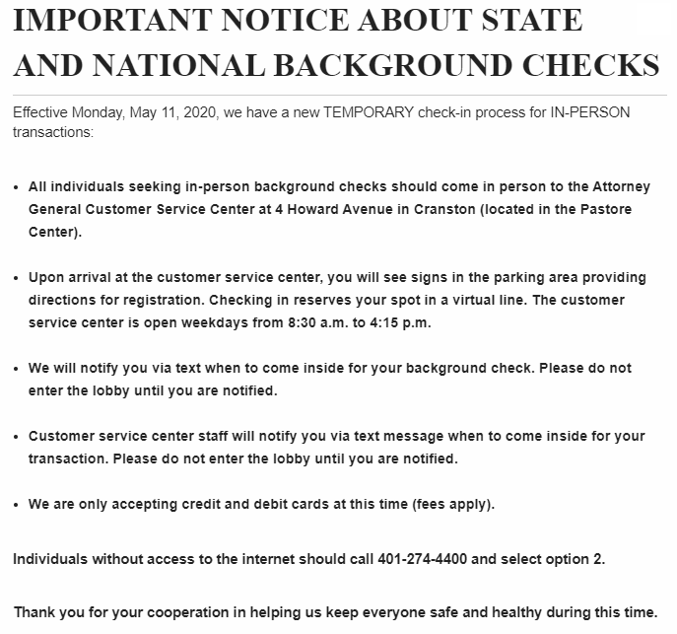
LEGAL REQUIREMENTS
BCI performed by the Attorney General's Office will ONLY be available at the address below:
Attorney General Julius C. Michaelson Customer Service Center
4 Howard Avenue (corner of Pontiac Ave. and Howard Ave.)
Cranston, RI 02920
401-274-4400
http://www.riag.ri.gov/BCI/index.php#
Please submit BCI original and Volunteer application to our FACE Office
Mandatory Reporting Requirement:
All persons in Rhode Island are required by law (RIGL 40-11-3) to report known or suspected cases of child abuse and /or neglect to the Department of Children, Youth and Families with in 24 hours of becoming aware of such abuse/neglect.
*See mandatory reporting steps on handout.
Hotline 1-800-RI-CHILD (1-800-742-4453) to report child abuse and /or neglect
All Providence Schools volunteers are required to adhere to above legal requirements.
Notes:
Explain the forms as well as the nuance of BCI and Sex Offenders List.
Include a screen shot of a redacted BCI report and Sex Offender result.

Slide 10
Basic school protocols
PROTOCOLS
Basic SCHOOL Protocols once volunteer is assigned
✓ Dress attire must be appropriate for a professional environment
✓ Volunteers must Sign-in and out at all times. Schools may request to wear a volunteer badge. Volunteers cannot be left alone with students at any time.
✓ Report to volunteer assignment soon after signing in
✓ Once volunteer assignment has been completed, sign-out and do not wonder throughout the building (fire safety)
✓ Let the student and teachers know how you prefer to be addressed (Ms., Mrs. , Mr.)
✓ School Rules are to be followed
✓ Call the main office if you can’t come in to volunteer
✓ Adhere to the application disclaimer form – Confidentiality and liability clause
✓ Adhere to the Mandatory Reporting as required by law and PPSD protocols & Any additional protocols outlined by the school or District

Slide 11
Volunteers are encouraged to help recruit other volunteers!
To Do List:
1- Orientation (e-video or in person)
2- BCI/5.00 check/MO and ID
Disqualifying Offenses Mandatory Reporting Form Volunteer Agreement and Disclaimer
3- Volunteer Application
Q&A

Slide 12
WE THANK YOU!!!!
Volunteer Program & Central Records
379 Washington Street, Providence RI
401-456-9239
Carina Monge
Volunteer Program
&
Central Records Manager
CRO@ppsd.org

